Slide 1

LP-2 Submission
Mini Project on “Fake News Detection System”
Guided By: Prof. M. V. Sadaphule
Presentation By- Sonali Salunke SeatNo:B150234364
Kalyani Patil SeatNo:B150234335
Gayatri Babar SeatNo:B150234223
Bhumika Patil SeatNo:B150234334
<number>
Notes:
<number>

Slide 2
DMW ASSIGNMENT
Assignment No.1: Write a java/python program to implement K-means algorithm to cluster the given data.
Link:https://drive.google.com/file/d/1v5p_kOO5GEzuw8hGifEV9_vvzwb1aIzQ/view?usp=sharing
Assignment No.2: Implement Apriori approach for data mining to organize The data items on a shelf using following table of items purchased in a mail.
Link:https://drive.google.com/file/d/1ezsm59HjqfE7FKkB85zuWIHPXklDQmnu/view?usp=sharing
Assignment No.3:Implement Navie Bayes to predict the work type for a person with following parameters: age: 30,Qualification:Mtech,Experience: 8, Following table provides the details of available data.
Link:https://drive.google.com/file/d/11xXpOcmL6a9Qx2ae3ELtzshNnuXauFRG/view?usp=sharing
Assignment No.4: Write a java/python program to implement classification algorithm to classify the given data using K-Nearest Neighbor method.
Link:https://drive.google.com/file/d/1DYSKq1CNaWnH2-GFSQMwe0VlWlt1Hx9k/view?usp=sharing
2

Slide 3
STQA ASSIGNMENTS
Assignment No.1: To study different types of software testing techniques with reference to Software Testing and Quality Assurance.
Assignment No.2: To study and perform Unit testing using testing tool Junit
.
Assignment No.3: Study and Implementation of Integration Testing for implementation software project in java/python/R.
Assignment No.4: To study Web based testing using selenium tool.
Link1: https://drive.google.com/drive/folders/1VYt9PVUc_81mE0hyJKe0oL9_O6EId-8r?usp=sharing
3

Slide 4
Problem Statement
The main Objective is to generate a model that can discriminate between “Fake” and “Real” news articles URL when it is trained with a certain dataset .
3

Slide 5
Contents
Problem Statement
Introduction
Software and Hardware requirement
Methodology
System Architecture
System Flow
Graphical User Interface
Result
Testing
Limitations
Future Scope
Conclusion
References
3

Slide 6
Introduction
Mass media sources, specifically the news media, have traditionally inform us of daily events.
In recent years, the reliability of information on the internet has emerged as crucial issue of modern society.
Our goal is to develop a reliable model that classifies a given news URL as either fake or real.
This model takes news URL as an input and classifies as fake or real.
3

Slide 7
Software and Hardware Requirment
Details of software
1. anaconda3
Important Packages:
1.Flask
2.Sklearn
3.pandas
4.matplotlib
5.numpy
Details of hardware
1. Minimum intel core i3processor
2. Minimum 4GB RAM
3. Minimum 5GB hard disk space
3

Slide 8
Methodology
Supervised machine Learning
Classification -
Navie Bayes Classification algorithm.
K-Nearest Neighbors classification algorithm.
3

Slide 9
Understanding Naive Bayes , K-Nearest Neighbors algorithm and Machine Learning :-
Machine Learning
Supervised Learning
Unsupervised Learning
Classification
KNN Algorithm
Naïve Baye’s
3

Slide 10
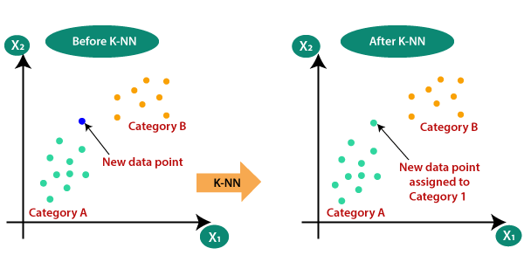
K-Nearest Neighbors Algorithm
10

Slide 11
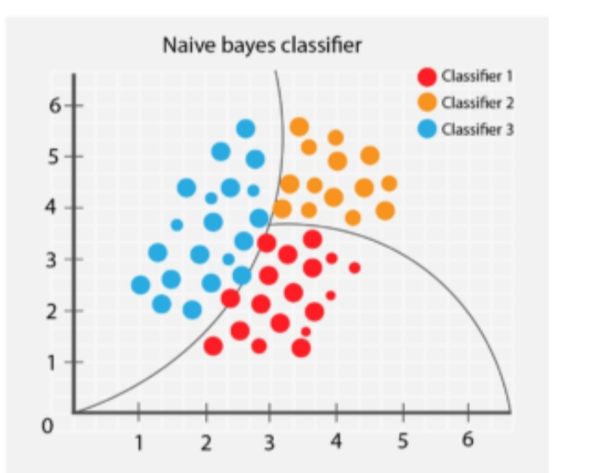
Naive Bayes Algorithm
10

Slide 12
System Architecture
KNN
Train set 80%
TfidfVectorizer
Dataset of Real and Fake news
Naïve baye’s
Test set 20%
Accuracy
Predict on Test set
<number>

Slide 13
System Flow
Articles information loading
Articles filtering based on the presence of the content and relevant label
Seperating the data in training, validation and testing datasets
Training the Naïve Bayes and KNN classifier
Testing accuracy and evaluation
Classification of news as Real or Fake
<number>
Graphical representation of performance of Naïve Bayes and KNN classifier
Notes:
<number>

Slide 14
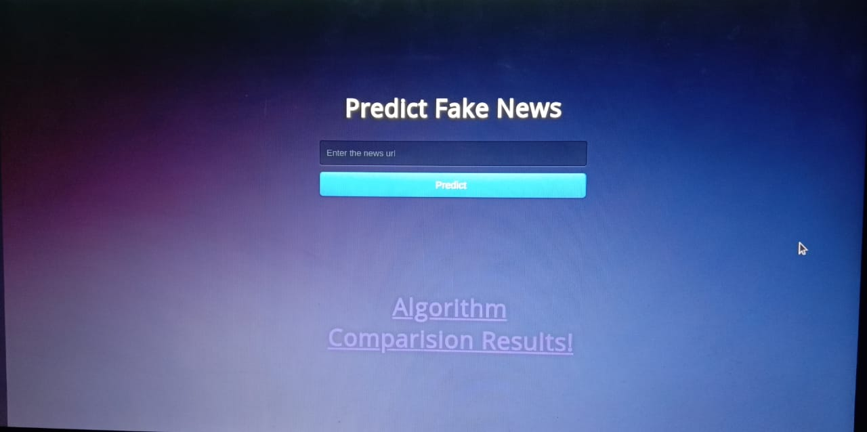
Graphical user interface
10

Slide 15
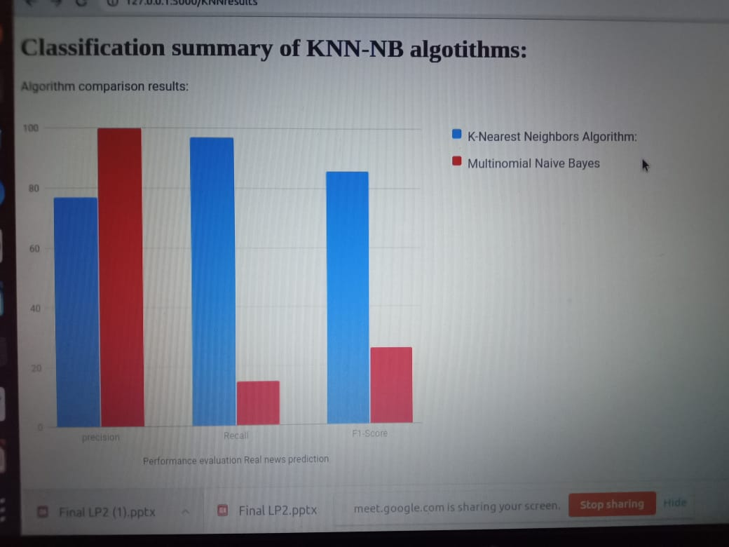
Graphical Representation
10

Slide 16
Result
Successful implementation of Machine Learning’s Naive Baye’s algorithm and K-Nearest Neighbors algorithm for Fake News Detection.
System successfully classifies given input news url as fake or real.
System classifies input news as fake or real with average accuracy .
10

Slide 17
Testing
Unit Testing -
Unit testing is a method by which individual units of source code are tested to determine if they are fit for use.
Library used for unit testing in python – unittest
Functions used in the project-
assertTrue(True)
check_dataset(self)
check_model(self)
Check_packages(True)
Selenium -
Selenium is a portable framework for testing web applications. Selenium provides a play Back tool for authoring functional tests without the need to learn a test scripting language.
10

Slide 18
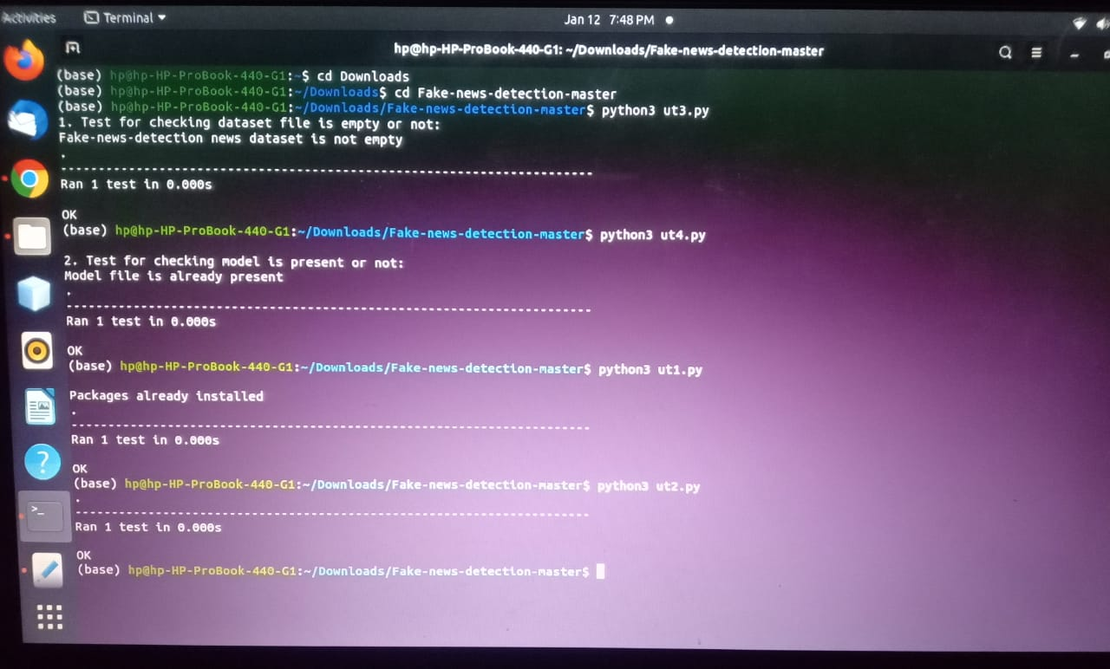
10

Slide 19
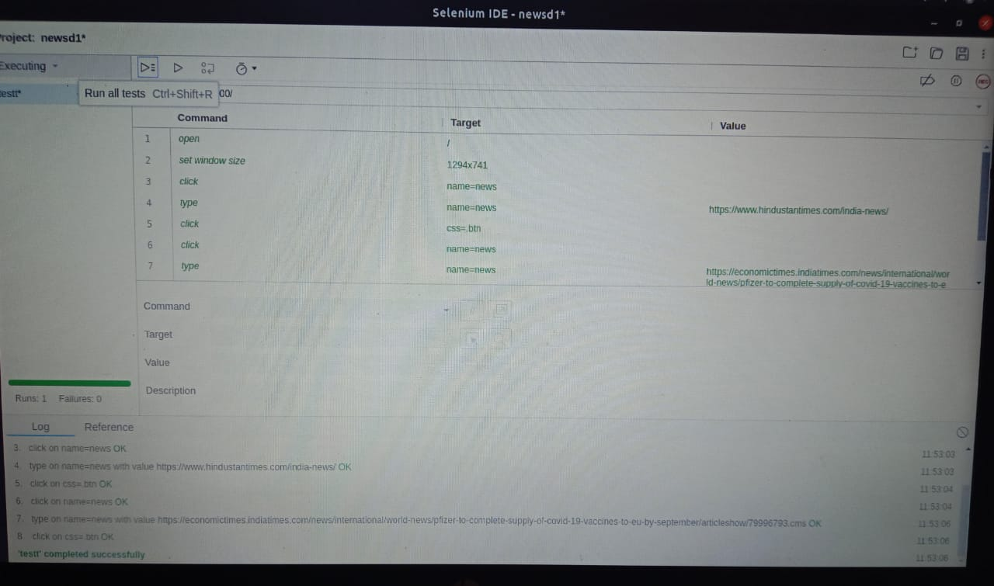
10

Slide 20
Limitations
Only one URL can be taken as an input at a time.
10

Slide 21
Future Scope
Training a classifier on a dataset with larger news articles should improve its performance signifcantly.
In our future work, news article data can be considered related to recent incidents in the corpus of data. The next step then would be to train the model and analyze how the accuracies vary with the new data to further improve it.
10

Slide 22
Conclusion
We achieved classification accuracy of approximately 85%,
this result can be further improved by expanding the training dataset.
So we conclude that that fake news detection problem can be addressed with these machine learning methods.
10
Notes:
<number>

Slide 23
References
www.wikipedia.com
www.youtube.com
https://ieeexplore.ieee.org/abstract/document/8100379
https://www.researchgate.net/publication/334192809_A_Study_on_Fake_News_Detection_Using_Naive_Bayes_SVM_Neural_Networks_and_LSTM
10

Slide 24
Thank You…!!
10

